Slide 1
Application of Heap Data Structure

Slide 2
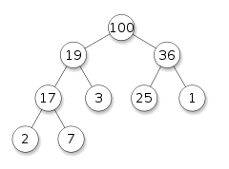
Heapsort and it’s application

Slide 3
Heaps and sorting.
Heap is a specialized tree-based data structure that satisfies the heap property.
Heap properties:
It has to be a complete binary tree.
It has to have any of the following properties:
Parent >= Children (max-heap)
Parent <= Children (min-heap)
Sorting: Arrange systematically in groups; separate according to type. Popular Sorting Algorithms: Bubblesort, Mergesort, Quicksort, Heapsort.
Sorting is used in:
File management, Memory management.
Dictionary.
Library etc,

Slide 4

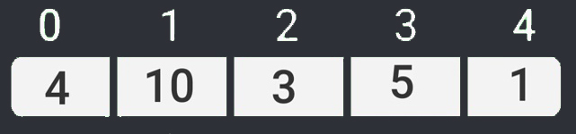
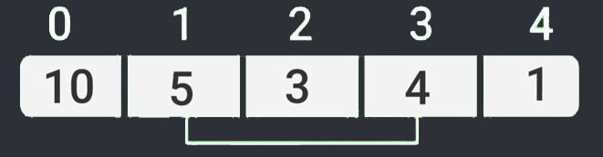
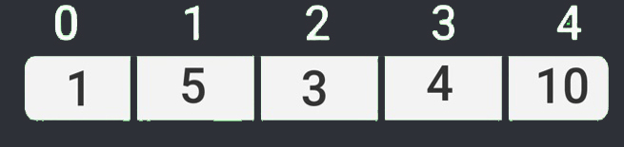
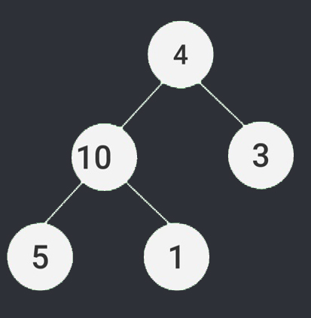
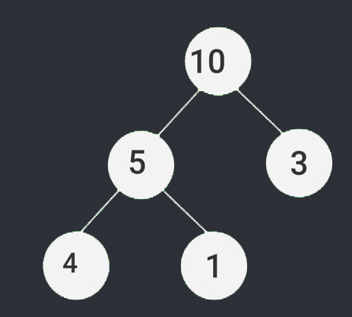
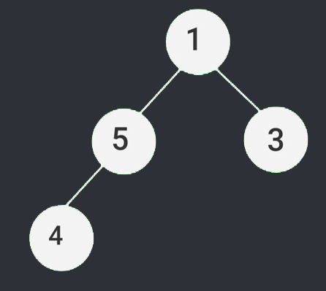
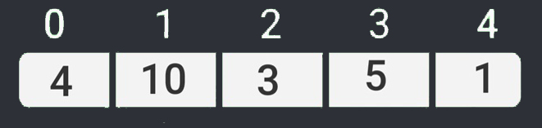
Heapsort algorithm.
1. Build a max heap from the input data.
2. Replace the root of the heap with the last item of the heap followed by reducing the size of heap.
3. Heapify the root of tree.
4. Repeat above steps until size of heap is greater than 1.
Creating heap
Building max-heap
Replace root with last element
Sorted array

Slide 5
Heapsort Code:
void heapSort(int arr[], int n)
{
for(int i = n/2 - 1; i >= 0; i--)
for(int i = n - 1; i >= 0; i--)
{
}
}
Creating max- heap
heapify(arr, n, i);
#
Creates max heap on reduced array
Swaps the first and last node
swap(arr[0], arr[i]);
heapify(arr,i,0);

Slide 6
Heap in Memory Management

Slide 7
HEAP IN MEMORY MANAGEMENT
Data structure "heap" might be used in various places.
Heap used for dynamic memory allocation wherever it is needed.
How to use heap in memory :
The heap is a region of computer's memory that is not managed automatically for , and is not as tightly managed by the CPU.
To allocate memory on the heap, we use malloc() or calloc(), which are built-in C functions.

Slide 8
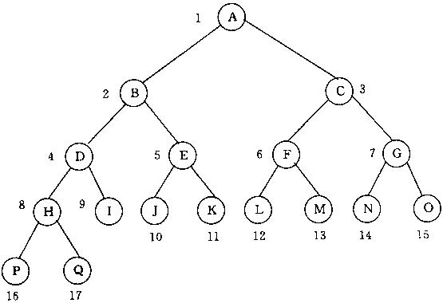
Example of Heap:
#

Slide 9
Why use heap in memory:
Variables can be accessed globally
No limit on memory size
No guaranteed efficient use of space, memory may become fragmented over time as blocks of memory are allocated, then free’d
User must manage memory
Variables can be resized using realloc()

Slide 10
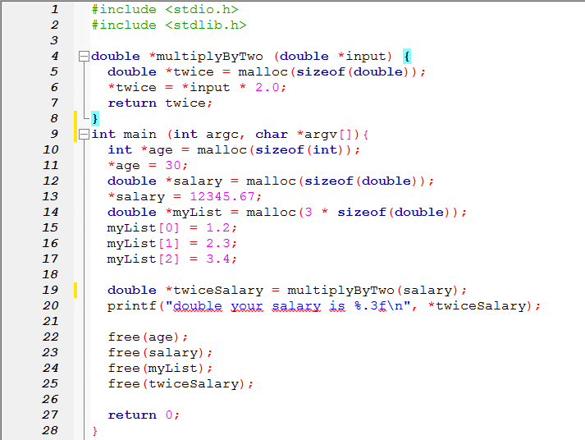
Code :

Slide 11
Selection algorithm

Slide 12
Selection algorithm
Selection algorithm is an algorithm for finding the kth smallest number in a list or array.

Slide 13
Selection algorithm
The idea of the quick select is quite simple: just like with quicksort, select a random element from the list, and place every item that is smaller to the first half of the array, and every element that is equal to or greater than the pivot, in the second half.

Slide 14
Selection algorithm
Working with large datasets is always painful, especially when it needs to be displayed in a ‘human readable’ format. It is a very frequent task to display only the largest, newest, most expensive etc.

Slide 15
Priority Queue

Slide 16
What Is Priority Queue: ?
Priority Queue: A priority queue is an abstract concept like "a list" or "a map"; just as a list can be implemented with a linked list or an array . Priority queues can be efficiently implemented using Binary Heap because it supports insert(), delete() and extractmax(), decreaseKey() operations.
There are two kinds of priority queue
max-priority queue
min-priority queue

Slide 17

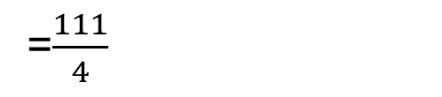
20
2
10
5
dequeue
enqueue
Avarage Wait time =
$$\frac{20+22+32+37}{4}$$
=$\frac{111}{4}$
~27

Slide 18


2
5
10
20
dequeue
enqueue
Avarage Wait time =
$$\frac{2+7+17+37}{4}$$
=$\frac{63}{4}$
~15

Slide 19
In-place Insertion-sort
Instead of using an external data structure, we can implement selection-sort and insertion-sort in-place
A portion of the input sequence itself serves as the priority queue
For in-place insertion-sort
We keep sorted the initial portion of the sequence
We can use swapElements instead of modifying the sequence
5
4
2
3
1
5
4
2
3
1
4
5
2
3
1
2
4
5
3
1
2
3
4
5
1
1
2
3
4
5
1
2
3
4
5

Slide 20
Other uses of heap

Slide 21
Uses of Heap:
Java
Python
PHP
C++ Standard Library
Pharos
Rust programming language
Go language

Slide 22
Thank you!

